Slide 1

B Laban Ice cream sales analysis
By Shay Akhdar Sokkar Bara Maya Bara

Slide 2
Goal
Our goal is to discover if there is a statistically significant relationship between ice cream sales and temperature.
Null Hypothesis(H0): There is no significant difference in the average daily sales of ice cream across different temperature ranges.
Alternative Hypothesis (H1): There is a significant difference in the average daily sales of ice cream across different temperature ranges.

Slide 3
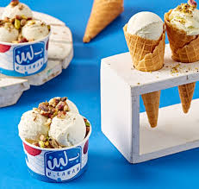
Why?
Ice cream vendors often assume that hotter days drive higher sales, leading them to increase stock and staffing accordingly. This study tests whether that assumption actually holds, which can help businesses allocate their resources more efficiently.

Slide 4

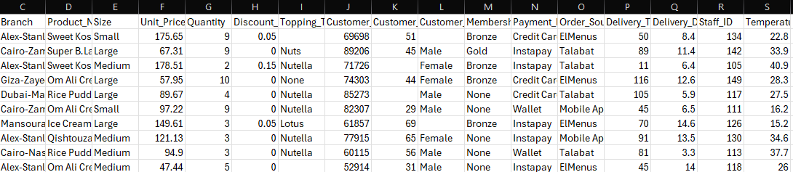
How?
We utilized a dataset containing over 7000 transactions across various B laban branches containing variables such as product name, category, temperature and much more.

Slide 5
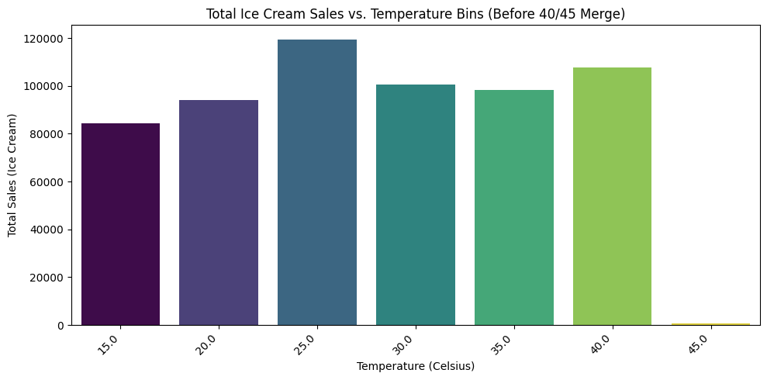
Visualization
We categorized the temperatures by grouping each 5 degrees together and made a bar graph showing these temperature groups against total ice cream sales.

Slide 6
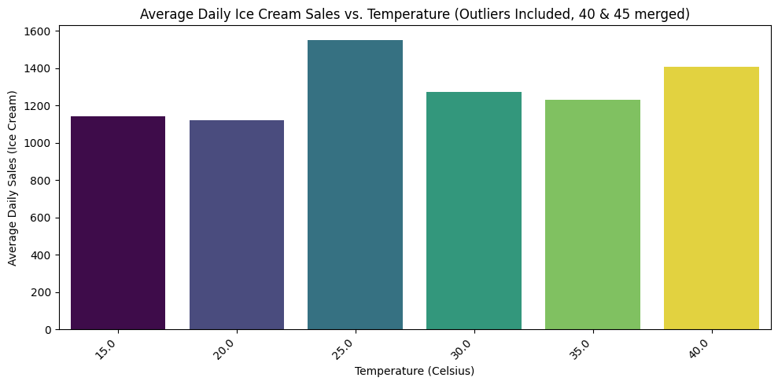
Visualization (pt. 2)
The 40-45 degrees group was very insignificant, so we merged it with the 35-40 group. We also divided by number of days to find the average daily sales.

Slide 7
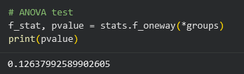
Analysis
We used a one was ANOVA test with a significance level of 0.05. It resulted in a p value of 0.126.

Slide 8
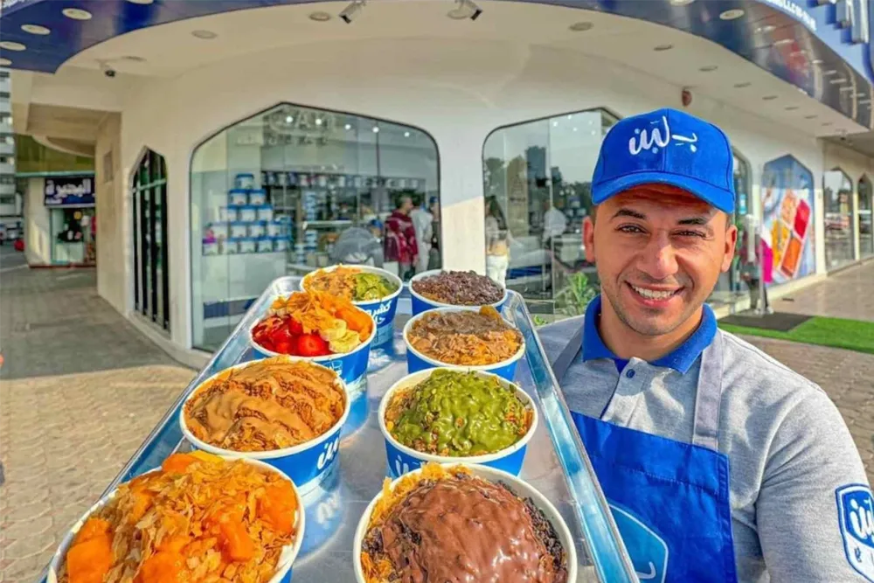
Conclusion
Since the p value(0.12) is greater than our significance level(0.05), we fail to reject the null hypothesis that states that there is no relationship between temperature and ice cream sales.

Slide 9
Thank You

